Slide 1

Correlation Analysis (part-1)

Slide 2
Learning Outcomes
Find out Whether there is any relation between or among of the variables.
Strength of the relationship.
2

Slide 3
OUTLINE
Define correlation
Types of correlation & its interpretation
Measuring correlation by drawing Scatter plot and interpretation.
3

Slide 4
CORRELATION with Examples
Correlation:
Correlation is a measure of relationship between two or more variables.
Example:
-ve 0
Advertisement X1
Sales Y1
Price X2
Demand Y2
+ve
X2 Y2
X2 Y2
X1 Y1
X1 Y1
No linear relation
4

Slide 5
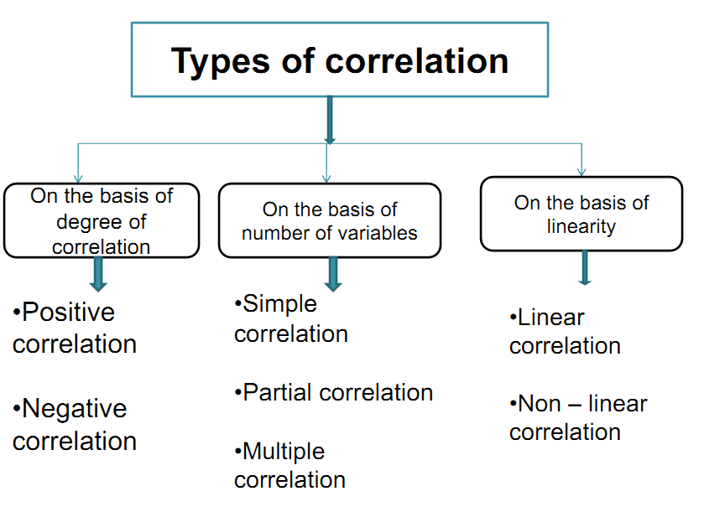
TYPES OF CORRELATION

Slide 6
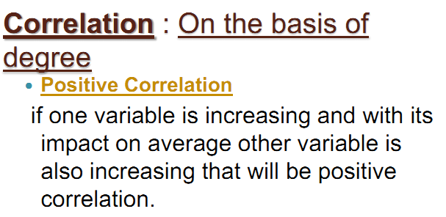
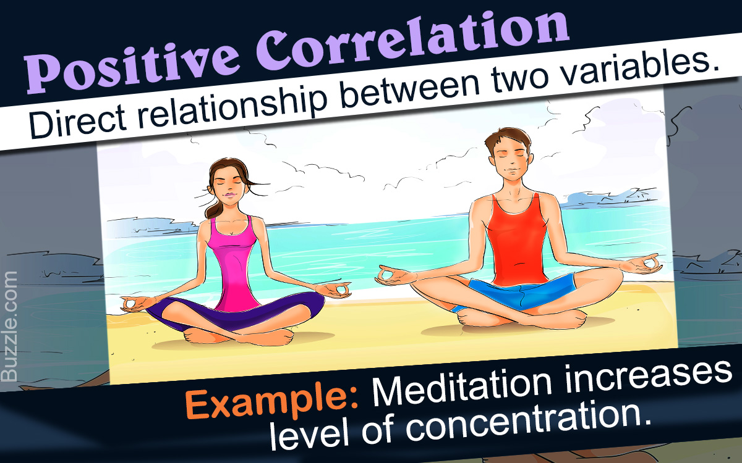
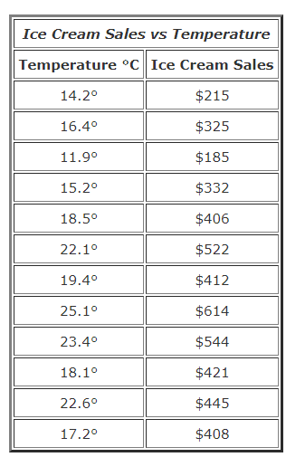
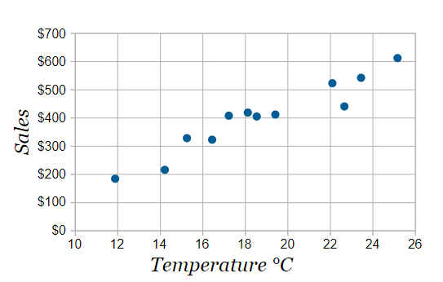
TYPES OF CORRELATION

Slide 7
TYPES OF CORRELATION
Examples of positive correlation in real life:
With the growth of the company, the market value of company stocks increase.
If I walk more, I will burn more calories.
When demand increases, price of the product increases (at same supply level).
When you study more, you score high in the exams.
When you pay more to your employees, they’re motivated to perform better.
With increase in consumption of junk food, there is increase in obesity.
When you meditate more, your concentration level increases.
Couples who spend more time together have a healthier and long-lasting relationship.

Slide 8
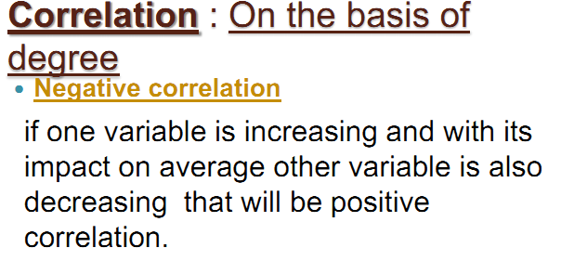
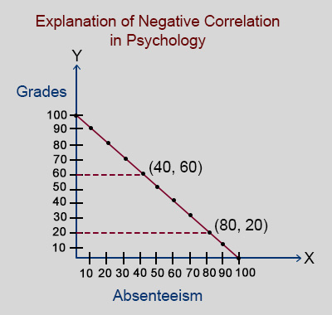

TYPES OF CORRELATION
Example:

Slide 9
TYPES OF CORRELATION
Examples of Negative correlation in real life:
The weight of a car and miles per gallon.
More absenteeism in school activities, less GPA.
More vaccinations, less illness.
More expenditure, less money.
More time for fun, less grades.
More time at work, less time at home.

Slide 10
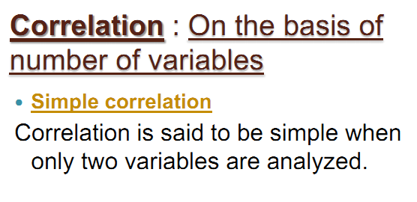
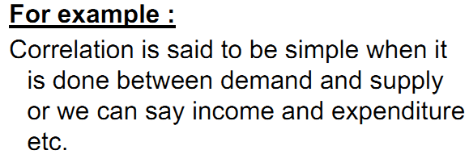
TYPES OF CORRELATION

Slide 11
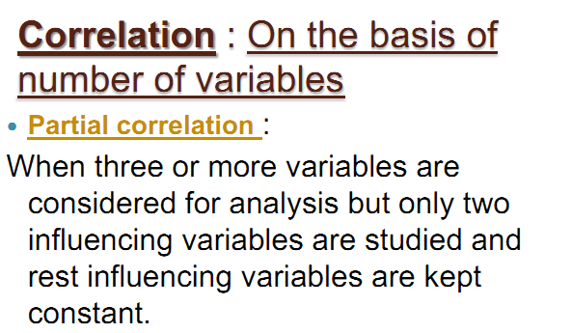

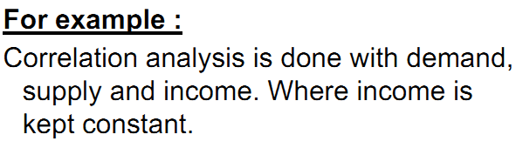
TYPES OF CORRELATION

Slide 12
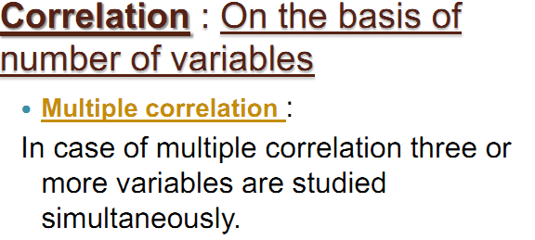
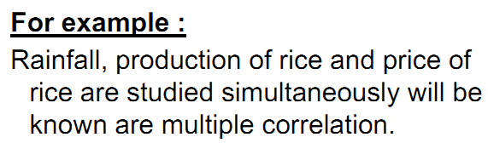
TYPES OF CORRELATION
Another examples:
Relationship among Demand, Supply and Product quality.
Relationship among Expenditure, Income and Family size.

Slide 13
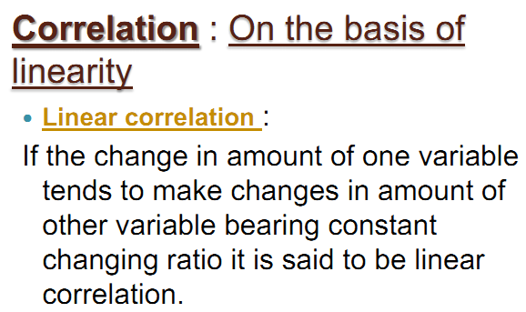
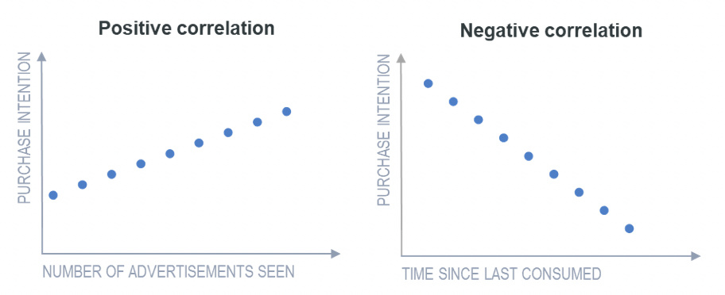
TYPES OF CORRELATION

Slide 14
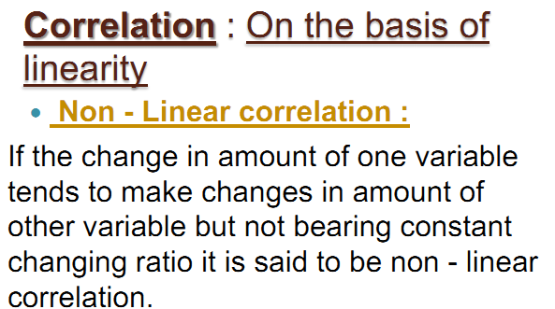
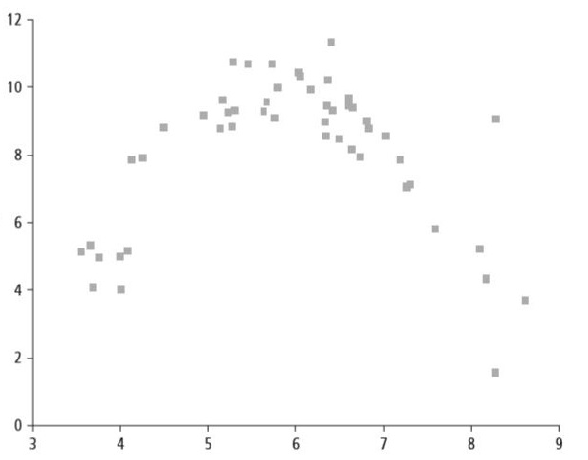
TYPES OF CORRELATION
Examples:
Nonlinear relationships also appear in real world situations, such as in the relationship between the value of a motorcycle and the amount of time you owned the motorcycle, or in the amount of time it takes to do a job in relation to the number of people there to help.

Slide 15
METHODS OF STUDYING CORRELATION
Correlation can be studied by the following methods:
We will practice the maths of these two techniques.
Scatter Diagram Method
Karl Pearson’s Correlation Coefficient
Spearman’s Rank Correlation Coefficient
Methods of Least Squares

Slide 16
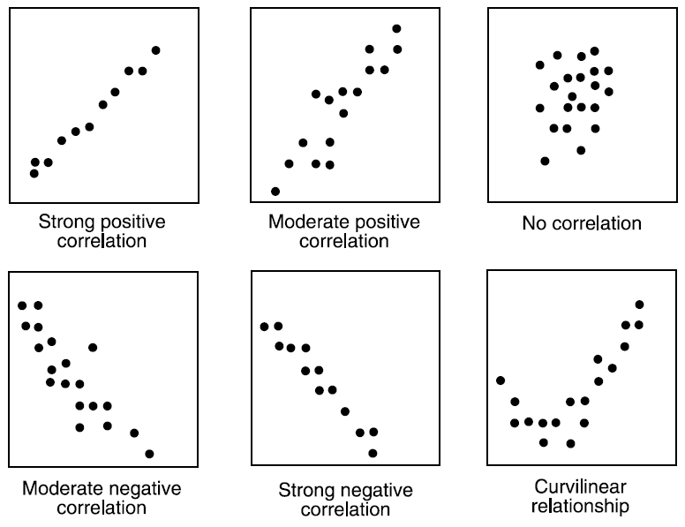
Scatter Diagram Method
1. Scatter Diagram Method

Slide 17
Procedure of drawing Scatter Diagram
Draw Scatter diagram and comment on the correlation.
Steps to draw Scatter diagram:
Considering one variable in X-axis and another variable in the Y-axis, find intersect points for each of the subjects.
Comment: With the increase of age, Glucose level is also increased, so there is a positive correlation between the variables.

Slide 18


